Slide 1
HOME AUTOMATION USING INTERNET
Created by:Mahadev sharma

Slide 2
Component used:
STM32F Discovery board
FT232R Breakout
ESP8266-01 WI-FI module
WI-FI router
Relay
Push button
Some resistors
Connecting wires and Power cables

Slide 3
Software and Environment used:
Ubuntu version 16
Arduino IDE 1.8.1

Slide 4
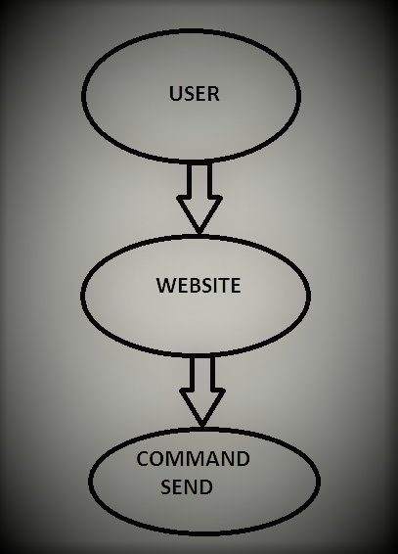
Functionality of project: (SENDING PHASE)

Slide 5
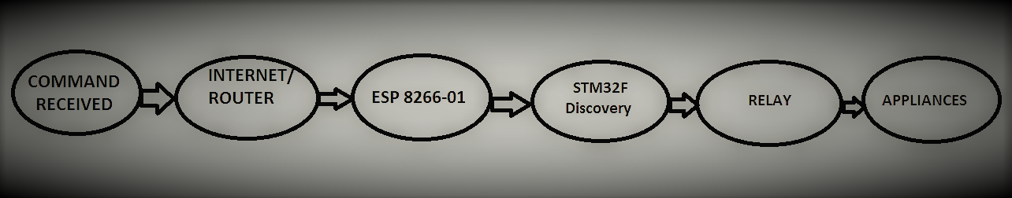
Functionality of project: (receiving PHASE)

Slide 6
How it works:
User send command using own website via internet
Website command received at internet router at home
Internet router is connect with Esp8266 module
Esp8266 module gives signal to STM32 board
STM32 board controls the home appliances with relay

Slide 7
FURTURE APPLICATION:
Temperature monitoring station
01
Humidity monitoring station
02
Soil moisture monitoring station
03
Smoke detecting station
04

